Slide 1

Identifying marketing investment efficiencies
Study name
LIFT ROI
Fecha

Slide 2

Agenda
Project status
Scope / Objectives
Timeline and next steps
Category overview
3. Brand focus
Media deep dive

Slide 3
1
Project status

Slide 4





Objective
Understand the impact of marketing efforts in sales and/or brand equity.
For that, we decompose sales volume and/or measured brand equity results, isolating the effects of each marketing effort to understand their individual effects.
Direct impact in
LiftROI Model
Sales
Equity
Input:
XX years of monthly/weekly data:
Brand sales, distribution and average price.
Media investment and media activity results (TV, OOH, Digital, etc.)
Other marketing efforts (owned media activity, innovations, promotions, etc.)
Macroeconomic variables

Slide 5
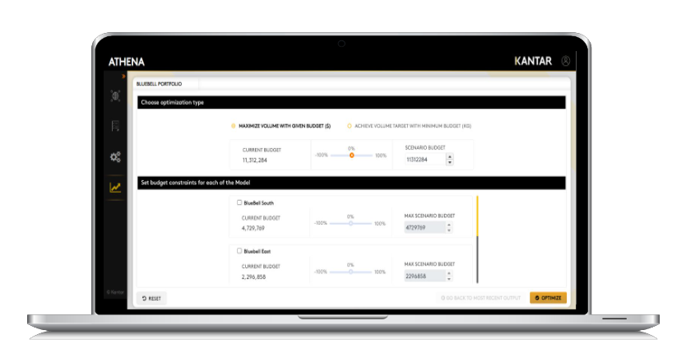
At the end, we’ll have the following results:
Illustrative
1. Sales decomposition / Equity decomposition
2. Incremental volume for each individual effort
1,280
X
1,080
Facebook
880
Search
680
Ventas / Equity
480
Banner
280
YouTube
80
Tiempo
3. ROI and saturation curves
4. Optimization
ROI | 2.8 | 3.4

Slide 6






Timeline
Average execution time since Kick Off ~ 17 weeks
Scope check |  | Data check | Insights check
1. Model design | 2. Data collection | 3. Data sign off | 4. Modelling | 5. Final report | 6. Simulations
Kick-off call | Data collection and validation | Data sign off for modelling | First presentation of model results | Final report delivery | Simulations
Scope Contact mapping | Data descriptives and variables transformations | Descriptives presentation to client Data sign off from client Data lockdown for modelling | Base presentation Contributions Preliminary checks | Final presentation Contributions ROI Saturation curves | Simulation scenarios for media planning
Week 0 | Week 1-3 | Week 4 | Week 5-11 | Week 17 | From week 17
%m-%d-%Y | %m-%d-%Y | %m-%d-%Y | %m-%d-%Y | %m-%d-%Y | %m-%d-%Y

Slide 7
Model technical spec (1/2)
Category: xxx
Brand: xxx
Period: xxx
Frequency: xxx
Analysis breaks: xxx
Coverage: xxx
Sales channel: xxx
Dependent variable: xxx

Slide 8
TEST

Slide 9
TEST

Slide 10
TEST

Slide 11
TEST

Slide 12
TEST

